Slide 1
PJM Energy consumption
Contributors:
Prianka Vikram, Robert Shim, Jaylen Hill, Josh Daisy, Eric Liu

Slide 2
Our motivation
As energy consumption continues to rise globally, accurately predicting future energy usage is crucial not only for efficient resource management but also for driving businesses. Utilities and energy providers face increasing pressure to optimize their operations and reduce costs in a competitive market.
We think the skills we have learned in this class are perfect to predict future energy usage to reduce waste and increase efficiency

Slide 3
Our Method
Our plan is to use past energy consumption data from PJM Interconnection LLC in order to create a supervised learning model that can provide insight into data trends of the future.
For example:
What time of the day is energy usage highest?
What about time of year?
Is energy usage steadily climbing?
There are many potential questions that our model will hopefully be able to help answer

Slide 4
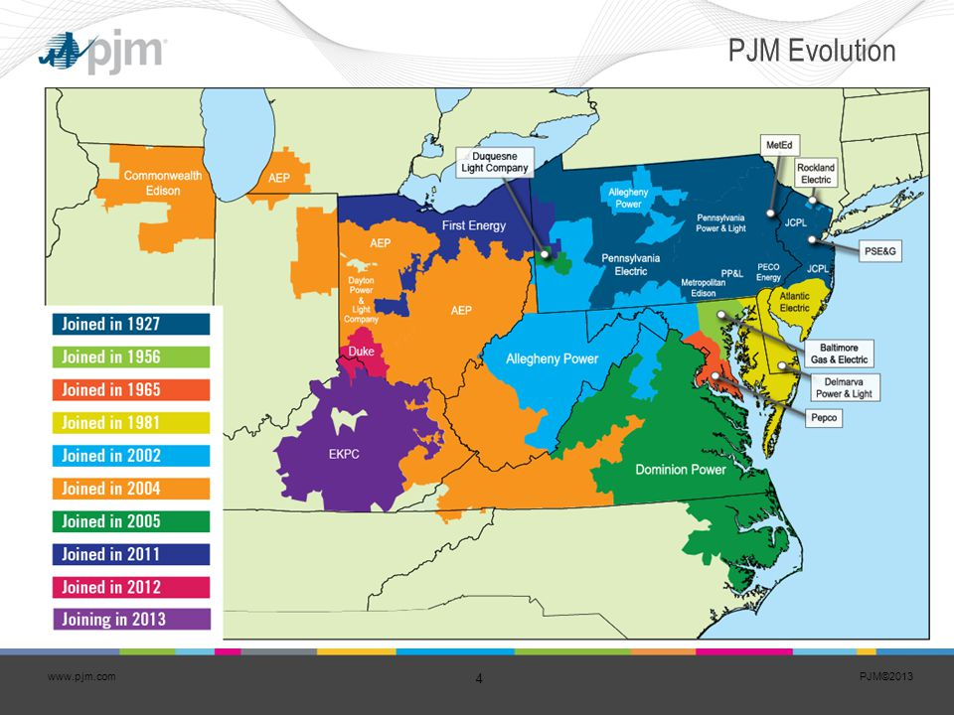
Our data
PJM Interconnection LLC is a regional transmission organization (RTO) in the United States. It is part of the Eastern Interconnection grid operating an electric transmission system.
Our data is split into the same regions shown on this map from the PJM website
The data from each of the respective utilities is time-series data of consecutive date times in hourly increments with a corresponding consumption figure in megawatts for each given DateTime.

Slide 5
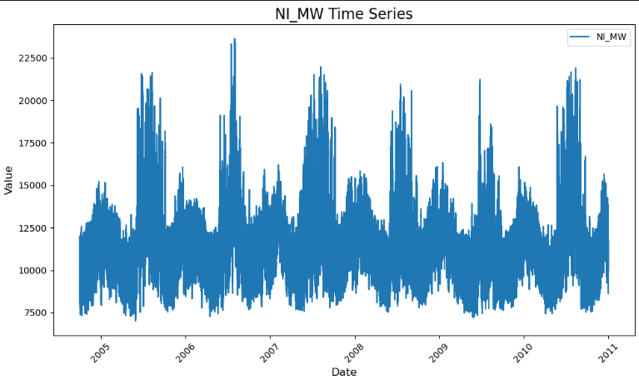
Our data
We have energy usage(measured in MW) as well as time for the various regions managed by PJM.
Just from seeing the data we can ascertain a rough pattern of when and where anergy usage is highest

Slide 6

Data Preprocessing

Slide 7
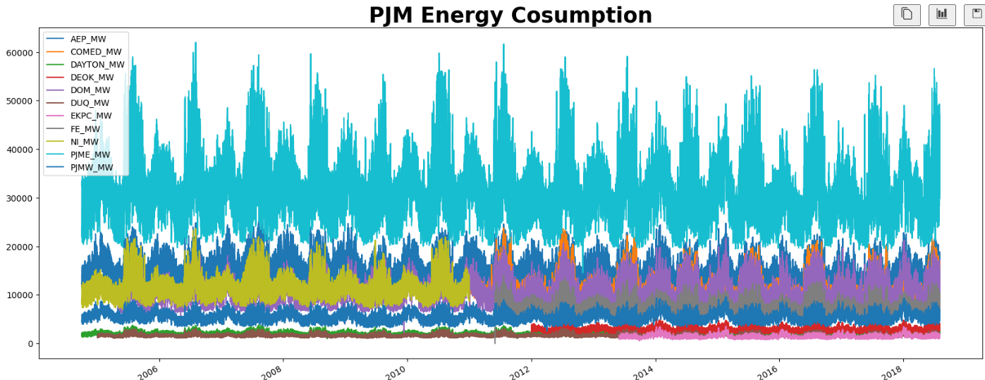
Investigating our data
With ​different regions of the PJM joining at different times we need to put thought into what and where to draw a sample from.

Slide 8
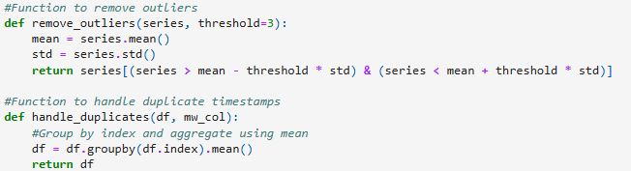
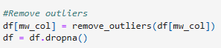
Outliers In Data
Outliers exceeding 3 standard deviations from the mean were removed.
Duplicate timestamps were aggregated by calculating their mean values.
Missing data (NA values) were dropped.

Slide 9

Challenges
A notable detail of the data we are working with is that the data in question is timeseries.
With this unique data type we need to utilize different methods than what we have learned previously through lectures
There are a number of unique models we can make use of that all have their pros and cons that we will have to weigh to determine which is best.
We plan on forecasting with the learning model, so there isn’t exactly a true or false value that we can look for, changing how we can look at predictive models.

Slide 10
Simple arma model
Linear model for time-series data

Slide 11
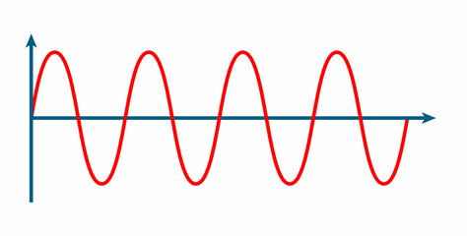
AR: Autoregression

Slide 12
AR: Autoregressive
ARma: AR + Moving average
ARIma: AR + Integrated + ma
SARIma: Seasonal arima

Slide 13
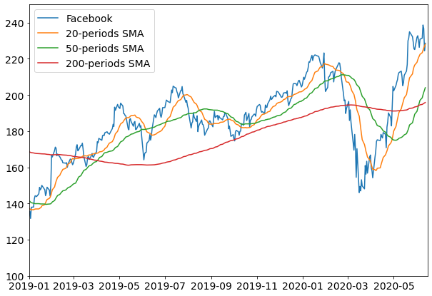
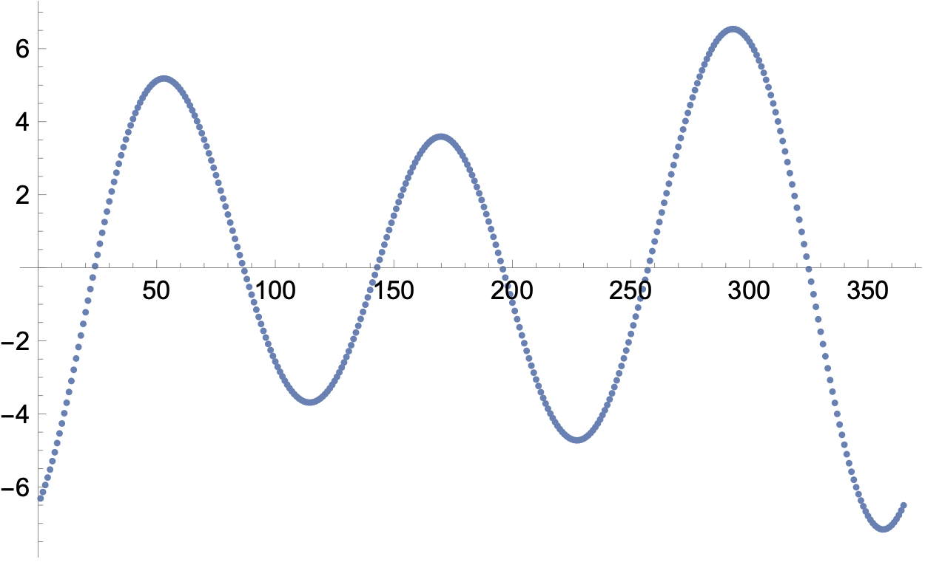
ARMA: Moving average

Slide 14
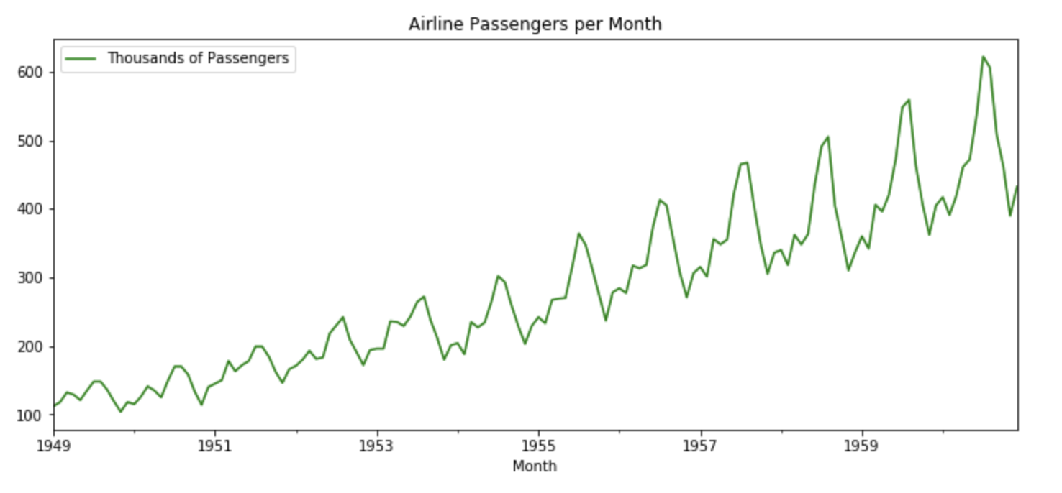
ARIMA: (gradual) increase

Slide 15
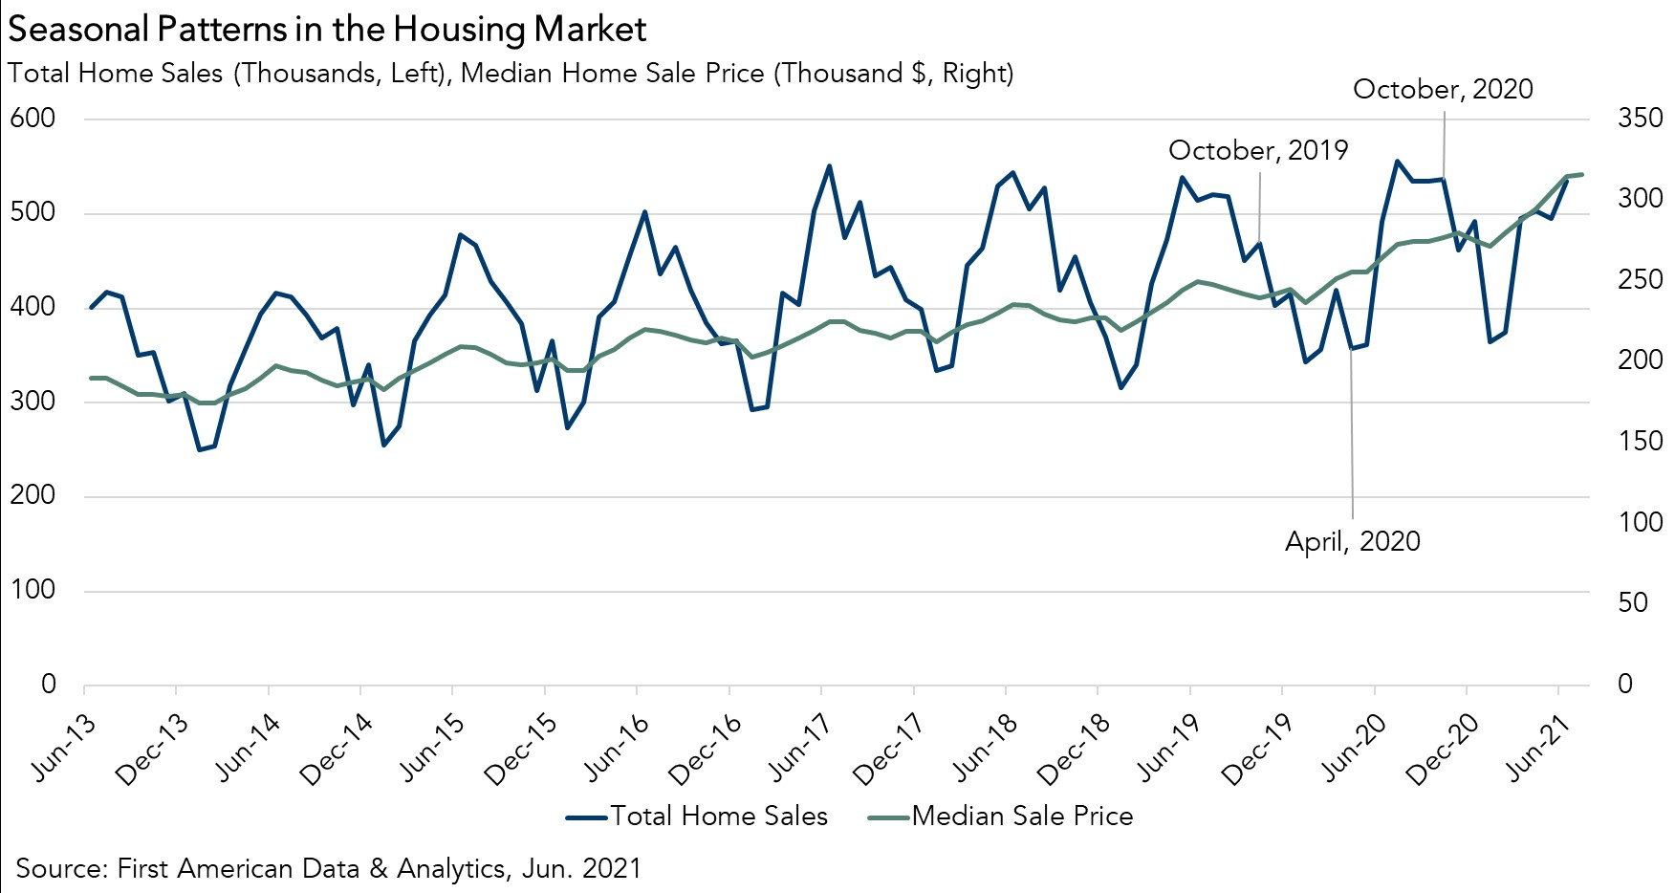
SARIMA: Seasonality

Slide 16
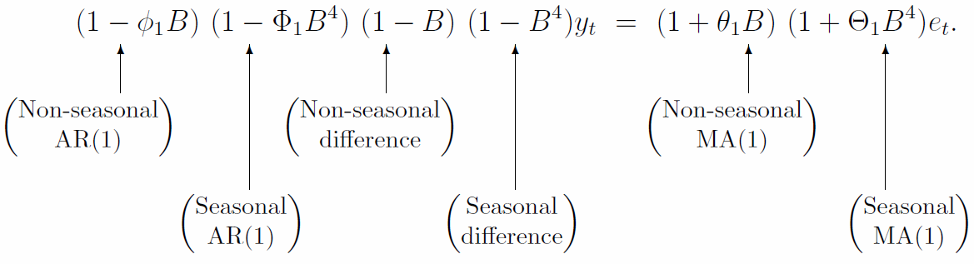
SARIMA Model

Slide 17
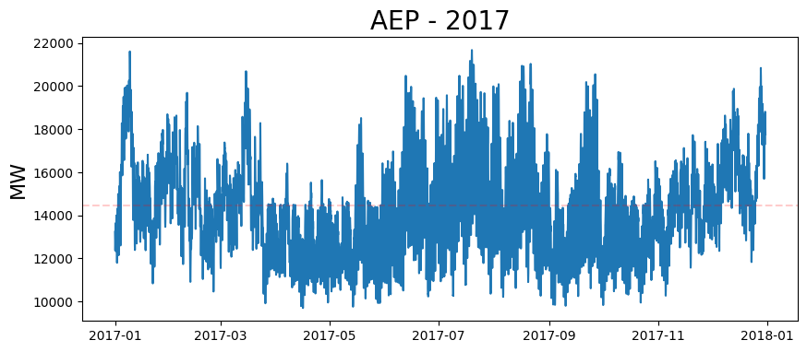
AEP Hourly Mega-watt consumption

Slide 18
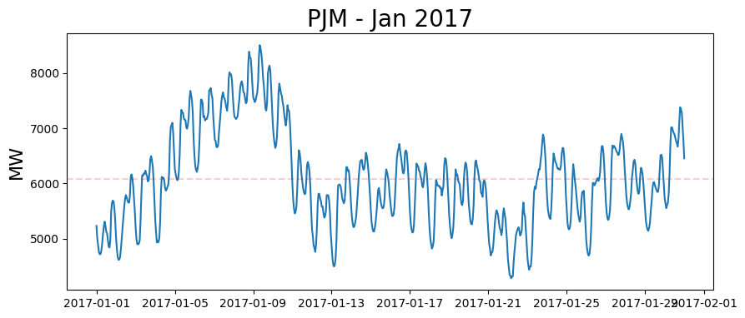
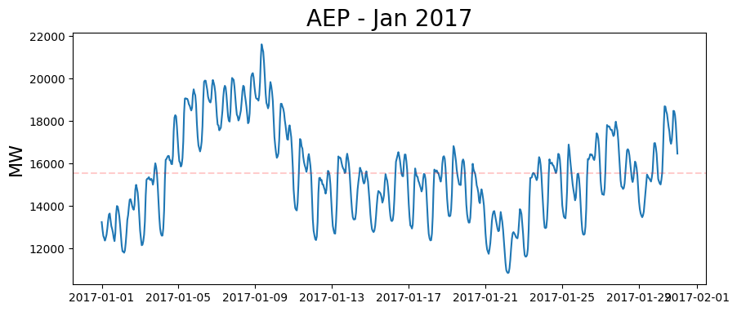
AEPconsumption – Jan 2017

Slide 19
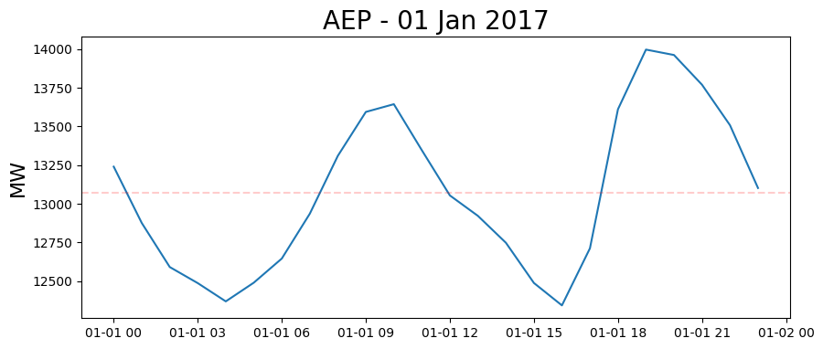
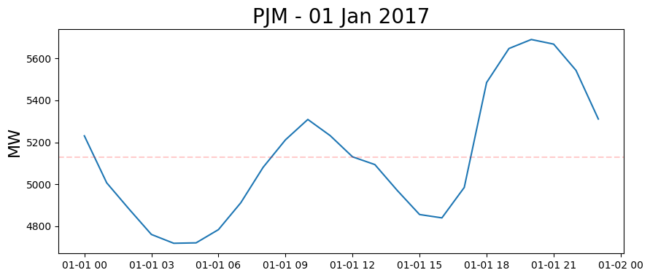
AEP consumption – Jan 1st, 2017

Slide 20
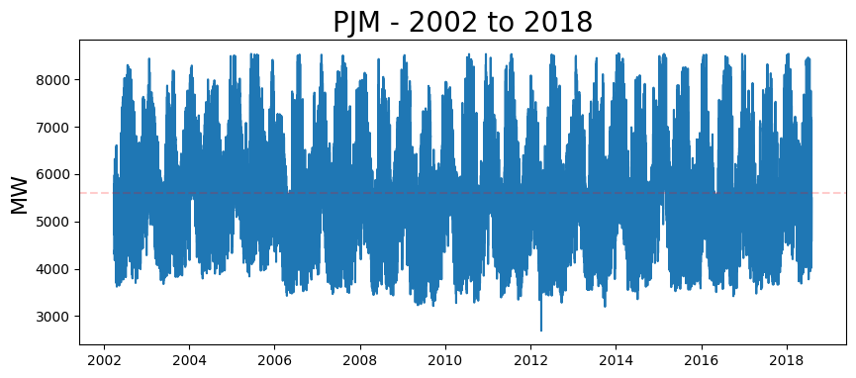
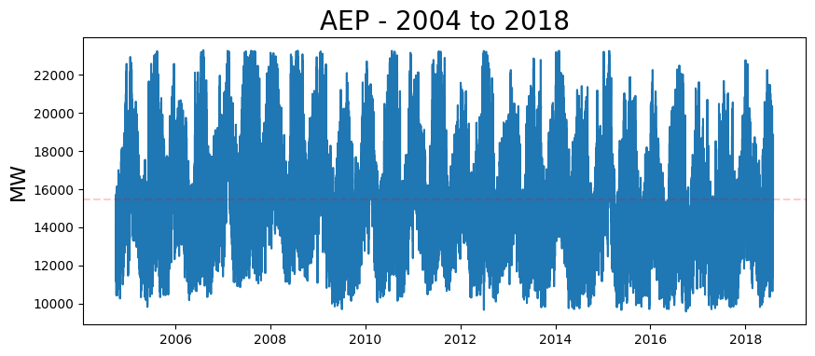
AEP consumption: 2004-2018

Slide 21
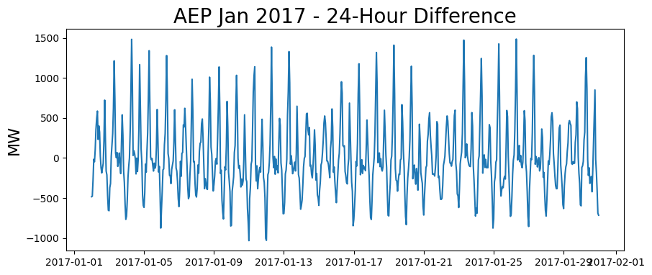
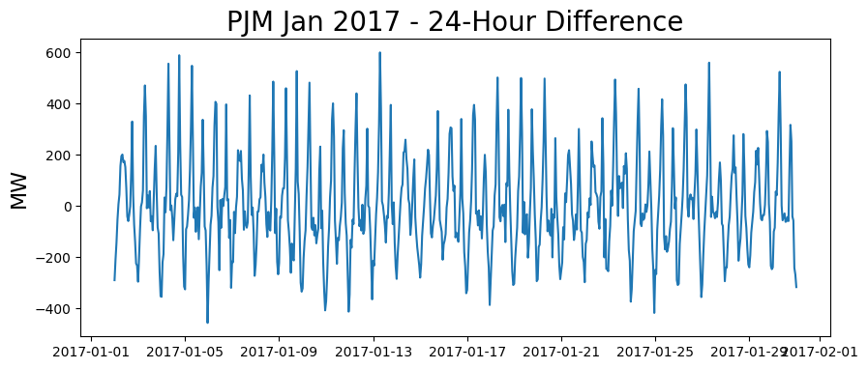
AEP consumption: Jan 2017

Slide 22
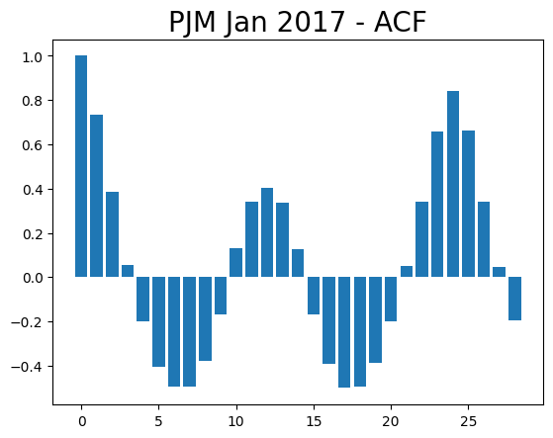
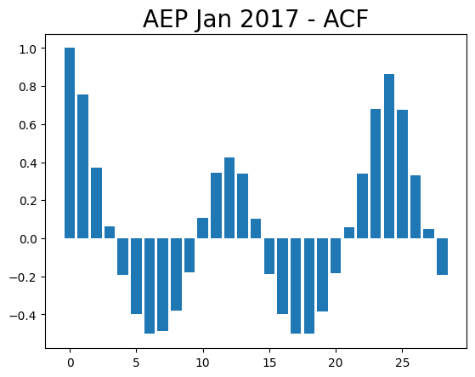
SARIMA Model - Parameter

Slide 23
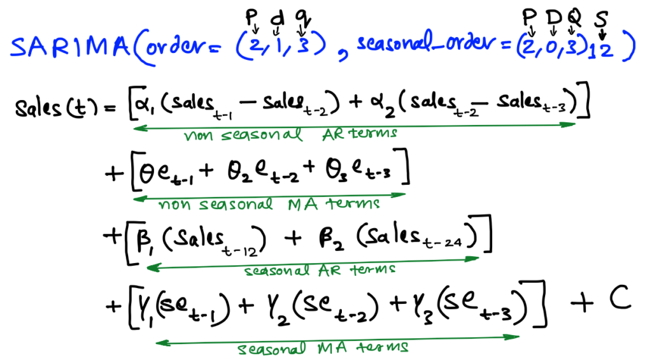
SARIMA Model

Slide 24
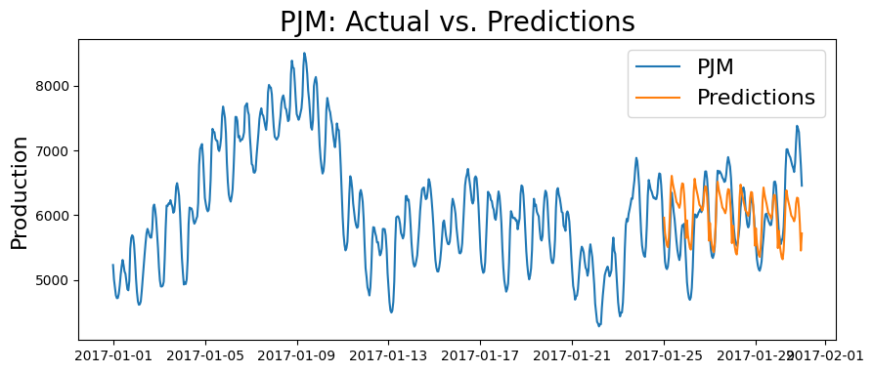
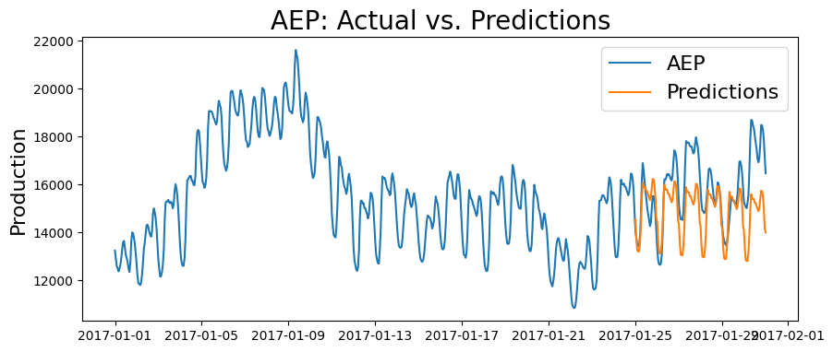
SArima model prediction

Slide 25
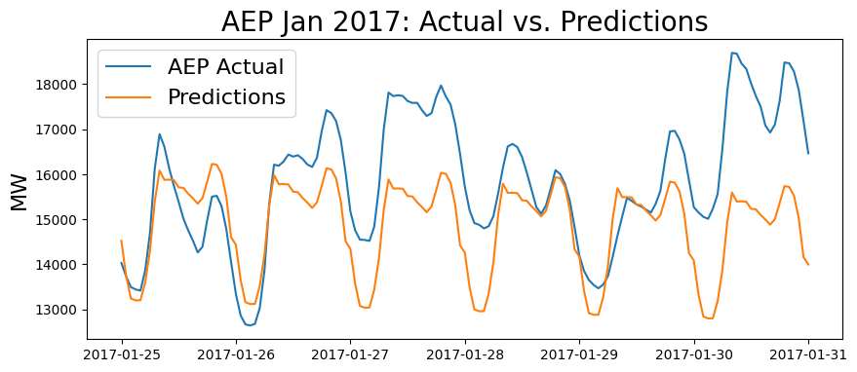
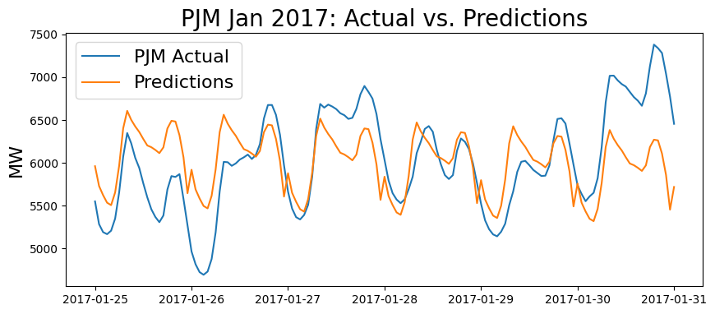
SArima model prediction
Mean Absolute Percent Error: .072
Root Mean Squared Error: 1466.49

Slide 26
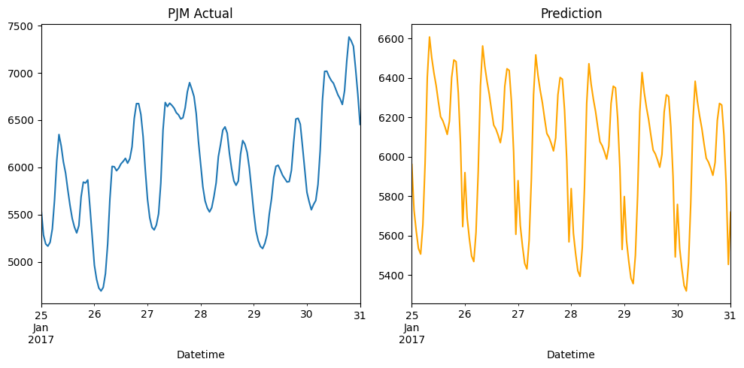
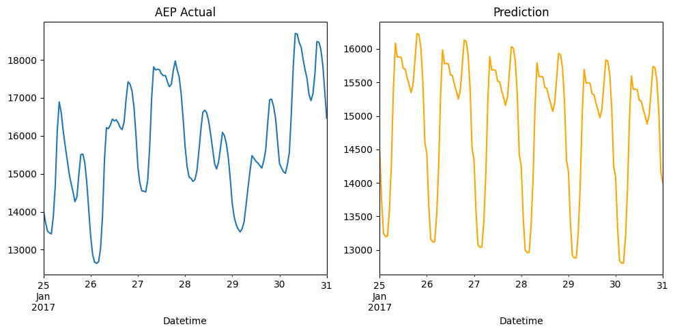
SArima model prediction

Slide 27
Supervised Learning Models
Our plans to predict the future

Slide 28
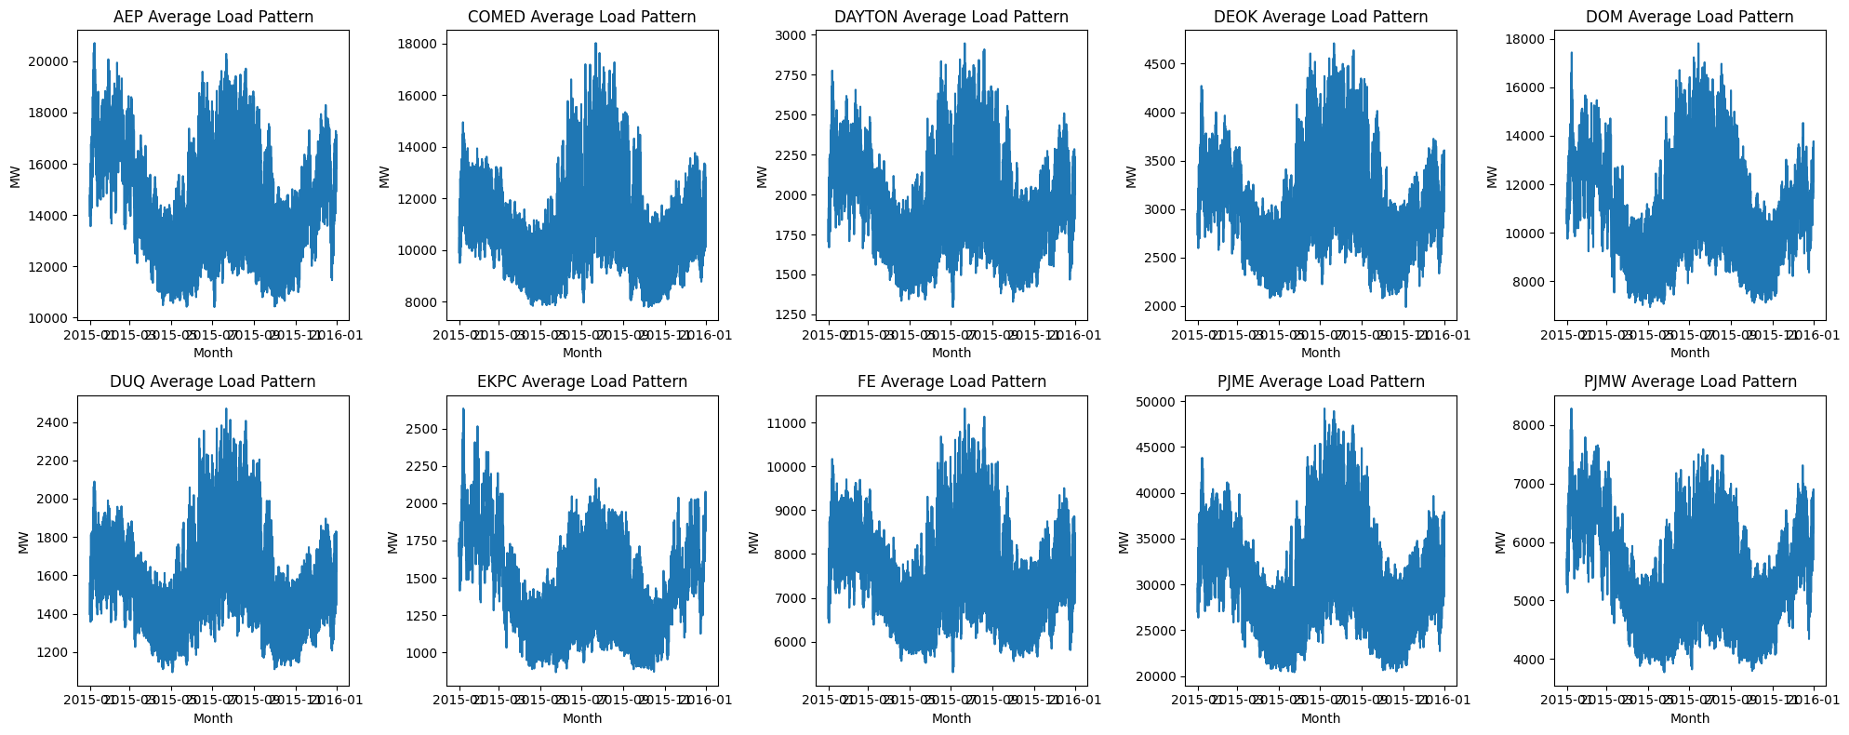
Multiplication chain approach
For this model, 10 datasets were chosen that contained datetime ranges between 12/31/2013 01:00:00 to 01/2/2018 00:00:00.
Below is a visualization of the yearly energy consumption of each of the ten utilities derived from a 4-year average for the respective datasets. The magnitude of the data differs greatly from utility to utility, but the shape and relative trends have very significant similarities

Slide 29
Multiplication chain APPROACH
The multiplication chain approach attempts to derive trends from the data on 4 different seasonality's/timescales - Hourly, daily, monthly, and yearly. For hourly, daily, and monthly, it attempts to create a multiplier dictionaries for the given seasonality's.
The hourly dictionary for example contains 24 entries for hours 0-23, each entry has associated with it a corresponding multiplier that describes to what extent that given hour exceeds or falls short of average hourly consumption over the course of 24 hours. A multiplier of .8 on hour 4 for instance would indicate that consumption at 5am on any given day should be around 20% less than the average hourly consumption for that given day. A multiplier of 1.2 at hour 11 then would indicate that consumption at 12pm on any given day should be around 20% more than the average hourly consumption for that given day.
The same approach is used for days, 0-6 representing a 7-day weekly seasonality. A value of 1.3 on day 3 would indicate that on Wednesday of any given week, one could expect the hourly consumption on that day to be 30% higher than the average in the given week
The same logic is applied to months which go from 0-11 and has 12-month seasonality.

Slide 30
Multiplication chain APPROACH
The idea behind the approach is that the shorter-term seasonality patterns are independent of the larger patterns. The relative trends in hourly consumption for a given day remain the same regardless of what day of the week it is. If people tend to consume 20% more energy at 9pm than their hourly average of the course of a day, then this pattern holds regardless if Tuesday or Saturday. Similarly, if people tend to consume 20% energy on Saturdays as opposed to Tuesdays relative to the average of the given week, then this pattern should hold regardless of what week of the month it is, or what month of the year it is. And once again if it’s the case that people tend to consume let's say 30% more energy in December say due to costs of heating than the monthly average of the given year, then this trend should hold regardless of what year it is. and for years which do not have a seasonality that were considering, we simply extract a multiplier from year over year growth in energy consumption
Predicting the energy consumption for any given datetime then only requires that we perform a series of multiplications on some base value. The process for this being
Start with a base hourly consumption value for a year x and target year y
Multiply it by its hourly factor
Multiply again by its day-of-week factor
Multiply by its monthly factor
Multiply it by the yearly growth factor times y minus x

Slide 31
Multiplication chain DATA Processing
Because for this approach we are only interested in relative trends within our seasonality's ,we can disregard the actual magnitude difference between our datasets and mean normalize all the datasets such 1 is "average" and anything above or below can be easily understood as a percentage deviation from that. 1.2 for instance is 20% more, .7 is 30% less. After this, we created a combined datasets that averaged the mean normalized values of each given date-time across the datetime range of 12/31/2013 01:00:00 to 01/2/2018 00:00:00. The reason this was done was to make it so that each dataset could "contribute" their own idiosyncrasies so to speak without our multiplier dictionaries becoming overfitted on them.
Hourly: Compare each hour's MW to its day's average MW per hour
If 3PM uses 1200 MW on a day averaging 1000 MW → multiplier = 1.2
Shows how much higher/lower each hour runs compared to day's typical usage
Daily: Compare each day's average MW/h to its week's average MW/h
If Tuesday has an average of 1300 MW/h in a week averaging 1000 MW/h → multiplier = 1.3
Shows which days consistently use more/less energy than others
Monthly: Compare each month's average MW/h to its year's average Mw/h
If July averages 1000 MW/h in a year averaging 900 MWh per month → multiplier = .9
Shows seasonal patterns in energy consumption

Slide 32
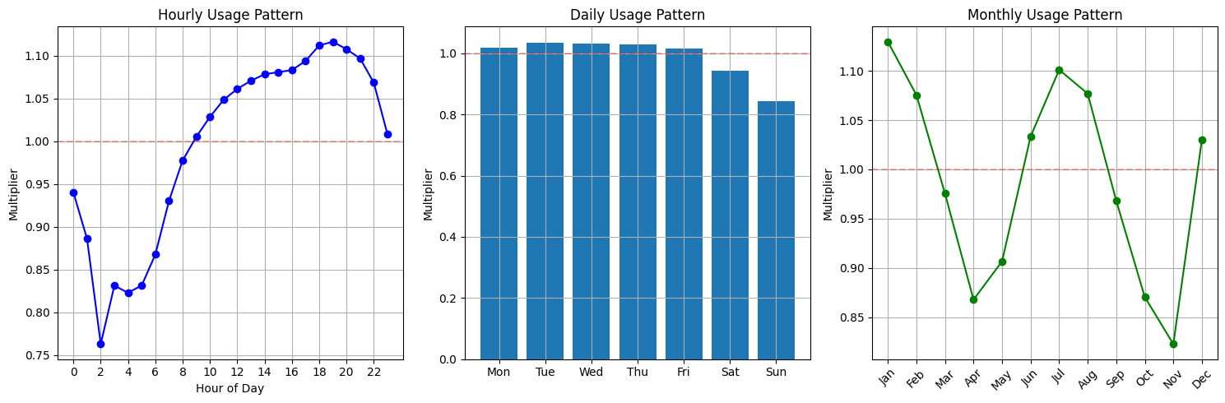
Multiplication chain Multipliers

Slide 33
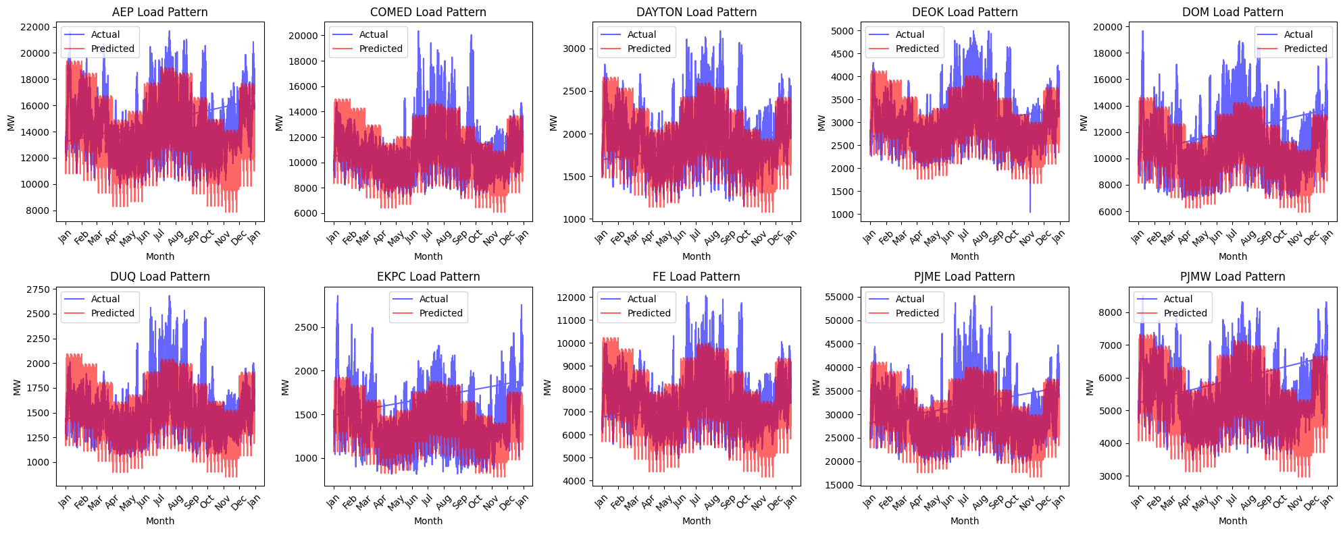
Multiplication chain results

Slide 34
Exponential Smoothing Model

Slide 35
Holt-Winters Exponential Smoothing
Holt-Winters Exponential Smoothing
Holt-Winters Exponential Smoothing is a time series forecasting method that extends simple exponential smoothing to capture data with trends and seasonality. It decomposes the time series into three components:
Level (L): The baseline value for the series.
Trend (T): The direction in which the data is moving over time.
Seasonality (S): Regular, repeating patterns within the data.
There are 2 types of models that could be used:
Additive Model: Used when seasonal variations are roughly constant over time.
Multiplicative Model: Used when seasonal variations change proportionally with the level.

Slide 36
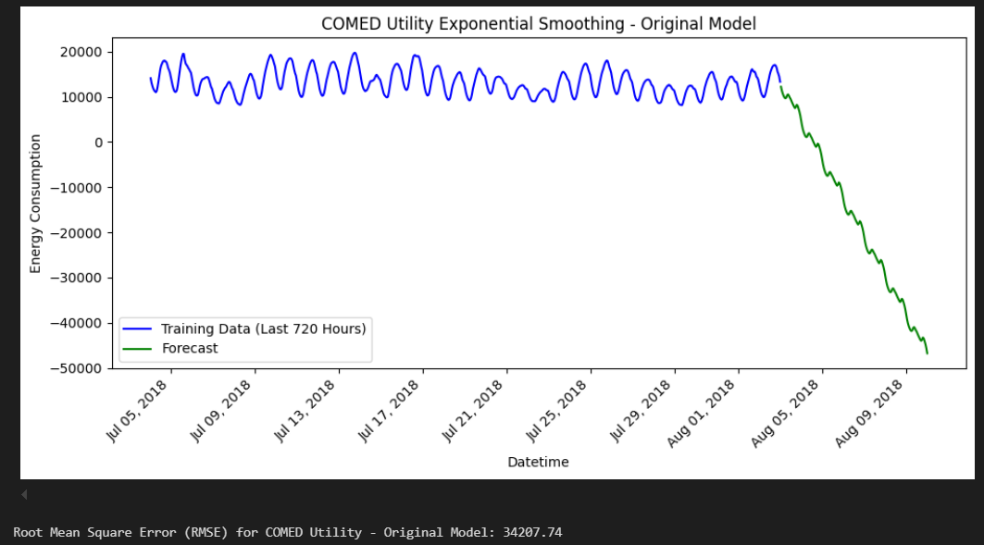
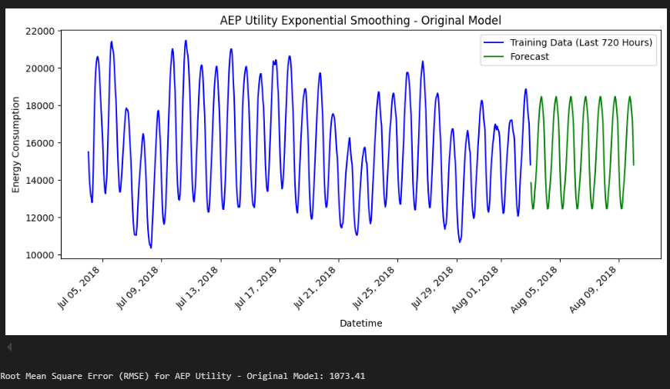
Analysis of holt-winters model
For the Initial Model...
We applied Exponential Smoothing with additive trend and seasonality.
The Seasonal period is set to 24 which captures daily patterns in hourly data.
How did the model do?
We calculated Mean Absolute Percentage Error (MAPE) and Mean Squared Error (MSE)
Higher RMSE values for utilities like COMED(34207.74) indicate significant room for improvement, possibly due to higher variability in energy usage patterns
Utilities with more predictable patterns, such as AEP, showed relatively lower RMSE at 1073.41.

Slide 37
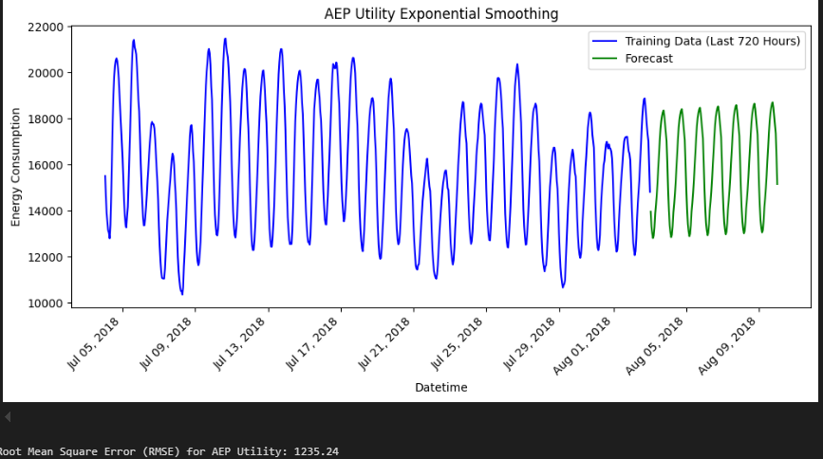
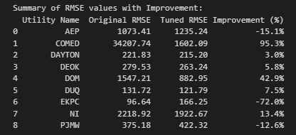
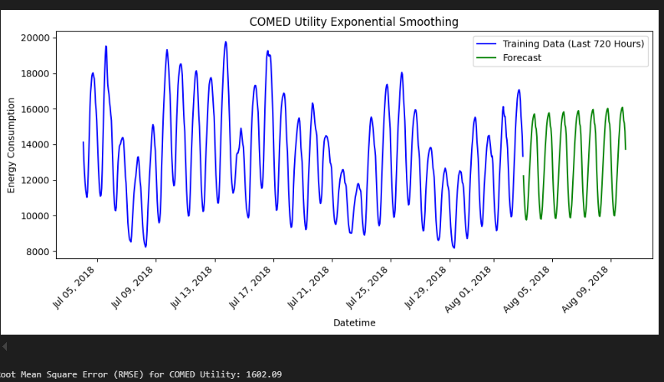
After Hyper Tuning – exponential smoothing
What adjustments were made?
We changed from additive to multiplicative to handle variations in seasonal amplitudes better.
We capped negative forecast at 0 to prevent unrealistic negative energy consumption.
What was the results?
There is a significant reduction in RMSE for several utilities, as seen COMED improved by 95.3%
But some models performed worse like AEP, the chosen hyper-parameters led to over fitting, where models started fitting noise rather than the true seasonal and trend pattern.

Slide 38
Information based Model
Random Forest with Time-Based Features

Slide 39
Why random forest and time-based features are a good choice:
Random Forests are particularly effective for time-series forecasting because:
Handling non-linearity: Random Forest can model complex, non-linear relationships between input features and the target variable (energy consumption in this case), which is often seen in time-series data.
Feature importance: Random Forest inherently provides feature importance scores, allowing us to see which time-based features (hour of the day, day of the week, month of the year) are most influential in predicting energy consumption.
Robustness to overfitting: Due to its ensemble nature (combining multiple decision trees), Random Forest helps prevent overfitting, which is crucial in time-series forecasting where the data may have patterns that are difficult to capture with a single model.

Slide 40
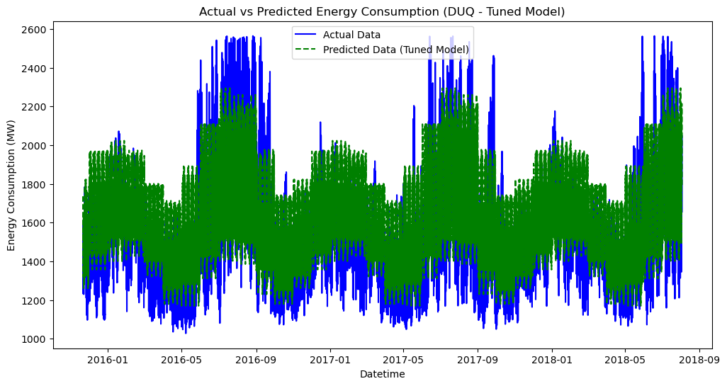
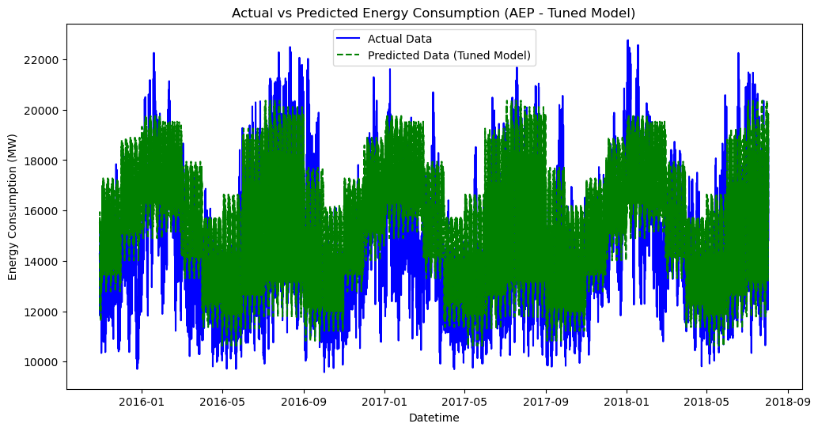
Ultimate takeaway:
The root mean square error (RMSE) of most datasets indicates moderate success in predicting energy consumption. For most utilities, hyperparameter tuning resulted in slight or no improvement in RMSE values, but this doesn't necessarily imply that the model is ineffective. On certain datasets, RMSE values as low as 196 were achieved, while the highest observed RMSE was 1837. Even though the RMSE values aren't perfect, this model still holds value in its ability to provide insights into how different features affect energy consumption patterns. (196 on top and 1837 on the bottom)

Slide 41
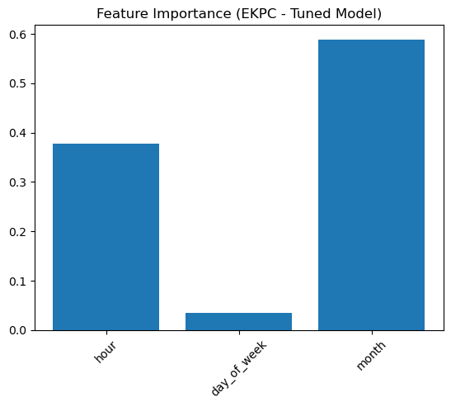
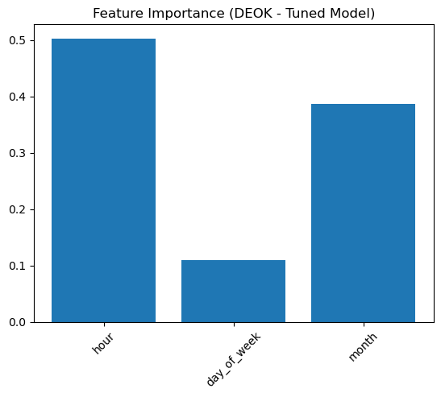
Feature importance insights:
Feature importance analysis revealed that, for most datasets, the hour of the day emerged as the most important feature, followed by month of the year in some cases. This suggests that energy consumption patterns vary primarily with the time of day, with some utilities also showing notable seasonal effects (as seen in the EKPC dataset, where the month of the year had a significant impact). This insight helps utilities better understand:
When energy consumption peaks during the day.
How seasonality affects energy demand throughout the year.

Slide 42
Error based Model
Linear Regression with Time-Based Features

Slide 43
Advantages and disadvantages of linear regression:
Linear regression’s most apparent feature is its simplicity, this gives it the advantage of very fast training speed and ease of implementation. However it’s weaknesses are clear when handling data like ours.
We can try to work around linear regressions subpar handling by creating new features to adjust the linear model to our non-linear data, such features are
Lag features: The model can take previous target values into account to try and predict future ones
Cyclical features: representing hour, days, and months as cyclical features captures the periodicity of time

Slide 44
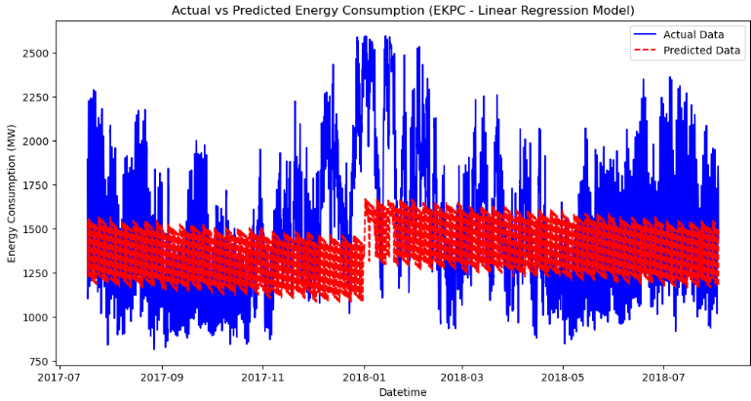
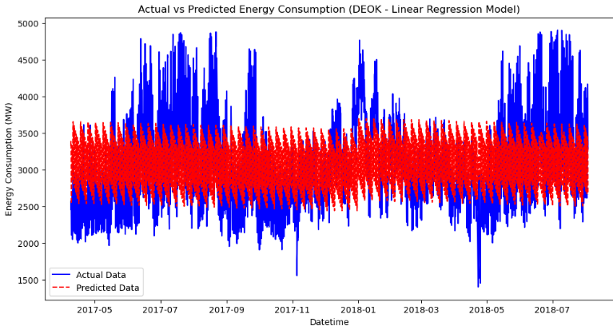
Baseline Model:
As seen from the images, baseline linear regression fails to capture trends present in the actual data barring that which occurs over the entire year.
It creates lines based on the most general trends but can’t keep up with more advanced patterns
The above graph has the highest RMSE, 335, normalized to 0.19
The below has the lowest RMSE of the base models, at 500, normalized to 0.14

Slide 45
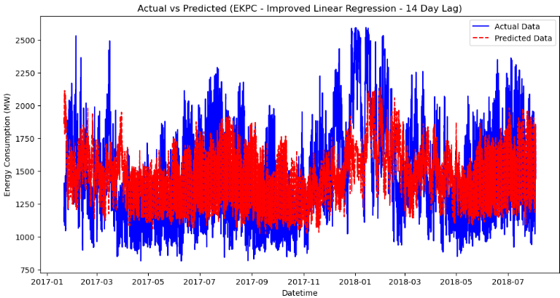
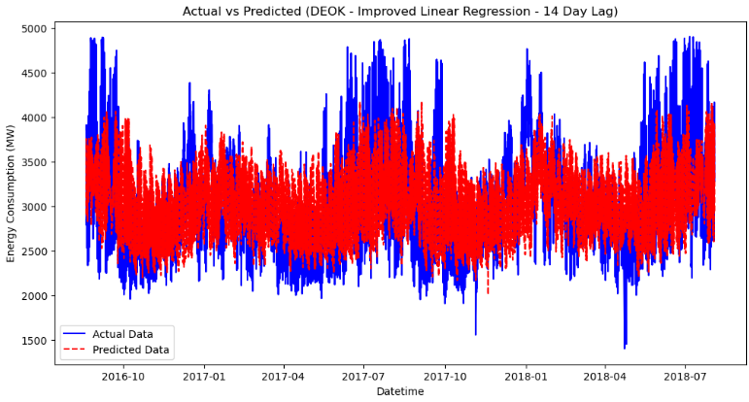
Improved Model:
Using lag features, the linear model can take into account past power usage to create predictions
The two graphs displayed are predicting the same as the previous slide, but this time they have an added feature of the power usage from 14 days prior
The above graph has the highest RMSE, 278, normalized to 0.16
The below has the lowest RMSE of the base models, at 460, normalized to 0.13

Slide 46
We will look at the code to fully understand the model From here

Slide 47
Model Selection

Slide 48
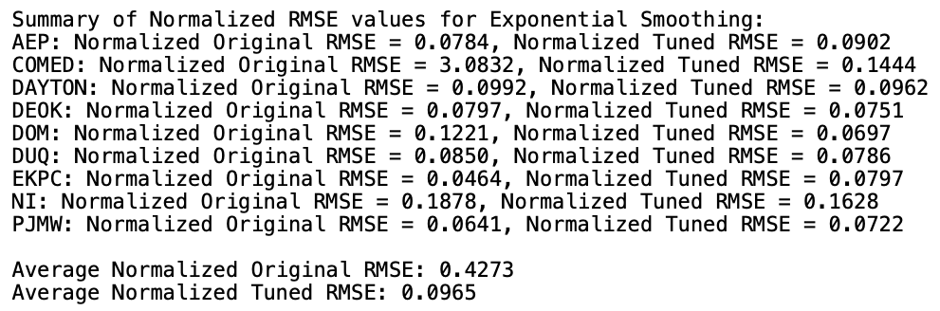
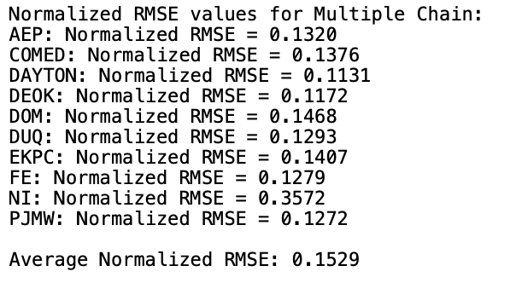
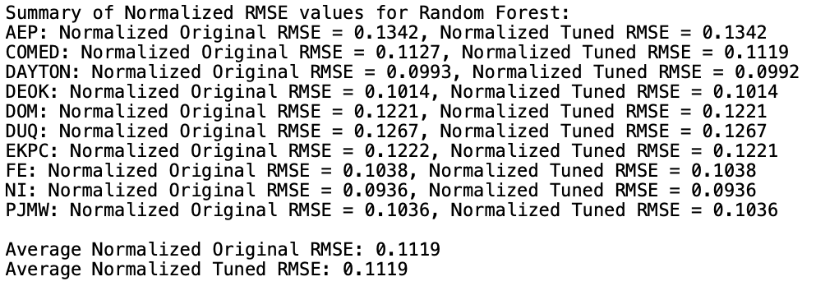
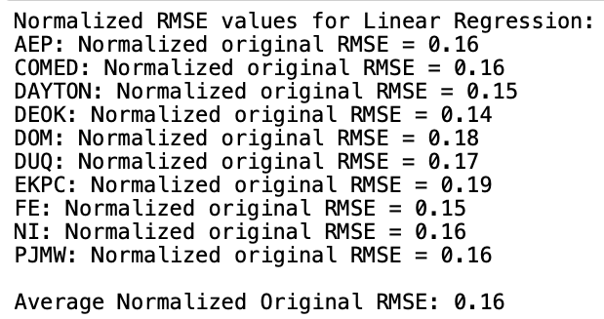
Evalutation and Selection
The barebones linear regression model, which all other models should be better than, has an average RMSE of 1095.2

Slide 49
Evalutation and Selection
Our main evaluation criteria we used was RSME since it provided us with a clear value of far off our models predications were from the actual values. Because we each had multiple datasets that we tested on and found RSME values for each we decided to compare the average value of RSME for a clear comparison on general performance. (As seen in the previous slide)
Based on the lowest normalized average RSME value of .0965 the best performing model and the model we decided to recommended is the Holt-Winters Exponential Smoothing.
NOTE: We decided to only test SARIMA on one dataset which it performed well on, but due to complexicty and it not performing significantly better then already tested models we avoided using it for the final evaluation.

Slide 50
Future work

Slide 51
Analyzing the models further
Right now the only criteria we used to select our model was based off RSME values to see how accurate the predictions of our models were. But do to the unique circumstances of the problem we are trying to solve many of our models offered insight into other useful information. Such Random Forests and how it can offer insight into which months consume the most energy, which hours of the day, etc.
So overall if we were to continue working on this project the biggest is finding more criteria to determine the most impactful model not only the best performing model.
Additionally, we want to make sure our data is easy to understand, we will change our models to display mean absolute percentage error instead of RMSE to determine model performance.

Slide 52
Any Questions?

Slide 53
Thank you!
Our GitHub
Our Kraggle dataset

